Slide 1
Dental Diseases Detection and classification
Farah Adnan Deeb Alarbid 0202228
Salma Ahmad Al Shakhshir 0202050
Rahaf Ayman Khorma 0207745
​

Slide 2
Introduction
In recent years, the application of artificial intelligence (AI) in healthcare has witnessed significant advancements, and one notable area of focus is the detection of oral diseases.
Time Save and management
Enhance Accuracy of Diagnosis
Early Detection of Diseases
Self-Diagnose

Slide 3
PRIMARY GOALS
Build Accurate Classification Model
Build Accurate Detection Model
Build a User-Friendly Interface.
Enhance Usability for Users and Doctors.

Slide 4
Kaggle Dataset
Found dataset consists of 14k image.
https://www.kaggle.com/datasets/salmansajid05/oral-diseases
Note that Dataset is diverse in terms of Images Positions, colors, cases
We used Kaggle notebook for project due to accessing GPU.

Slide 5
Kaggle dataset
Classification Dataset is almost 11000 file of images
Classification Dataset has 6 diseases and not perfectly balanced.
classification–caries, calculus, ulcer gingivitis, hypodontia, tooth discoloration
Detection Dataset is formatted for yolov5 model and is approximately 3000 files of annotated images and has only 4 diseases
detection-caries,gingivitis,ulcer,tooth discoloration

Slide 6
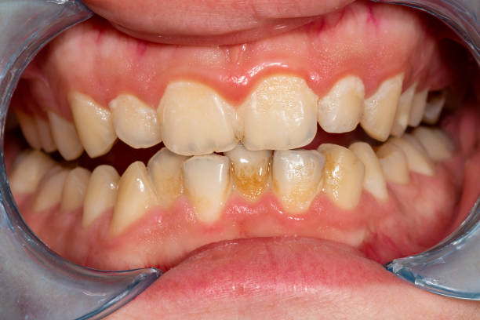
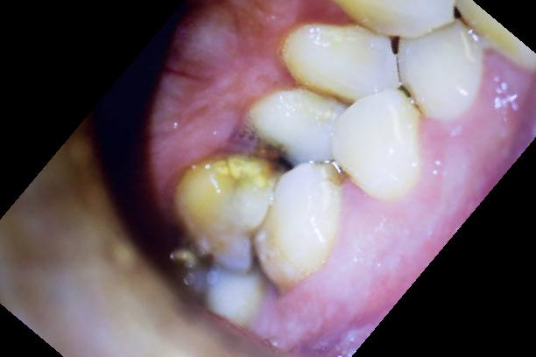
Kaggle dataset
We noticed that the images have different angles of capturing. Some of them are augmented.

Slide 7
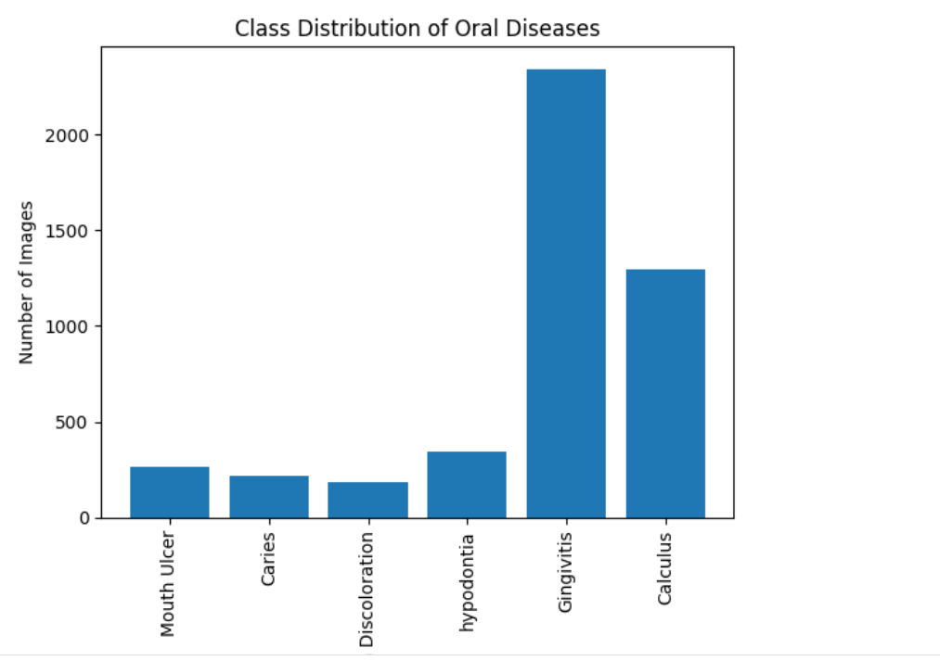
Issue 1 with classification data

Slide 8
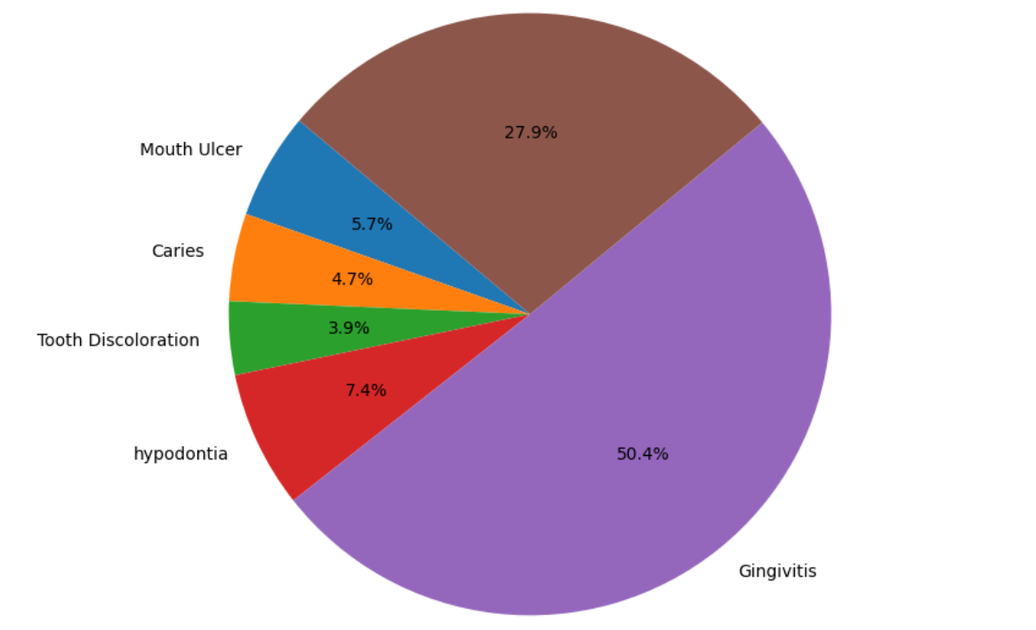

Slide 9
Detection Model Yolov5
Community Resources
Ease of use and Efficient results
Dataset was organized and annotated in YOLOv5 format.

Slide 10
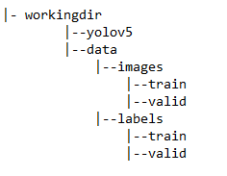

Detection Model Yolov5

Slide 11
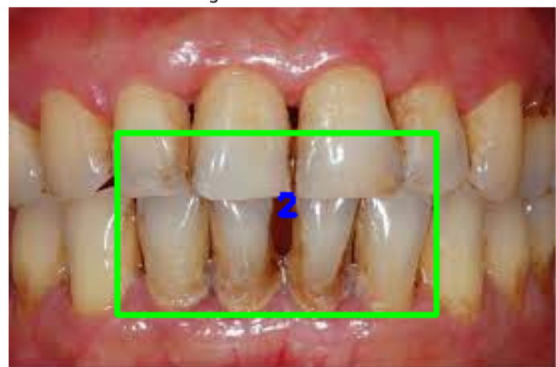
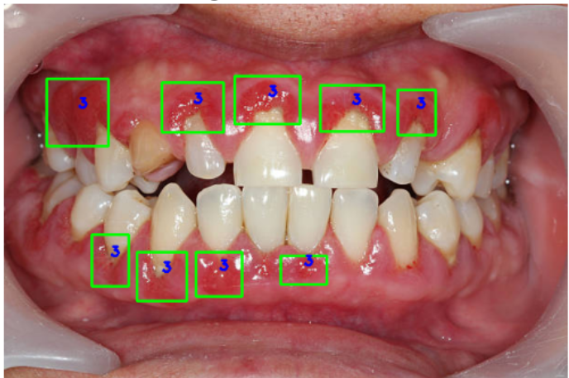
Issue 1 with Detection dataset

Slide 12
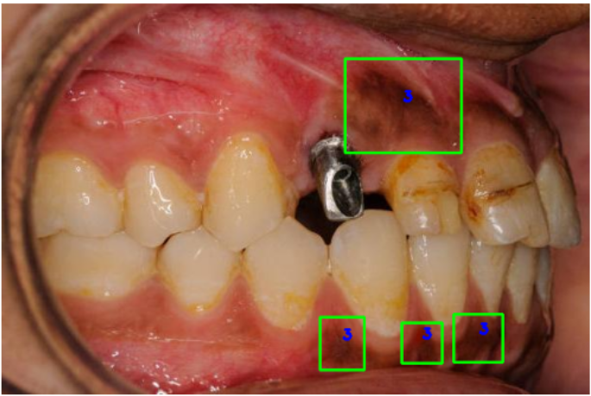

Slide 13
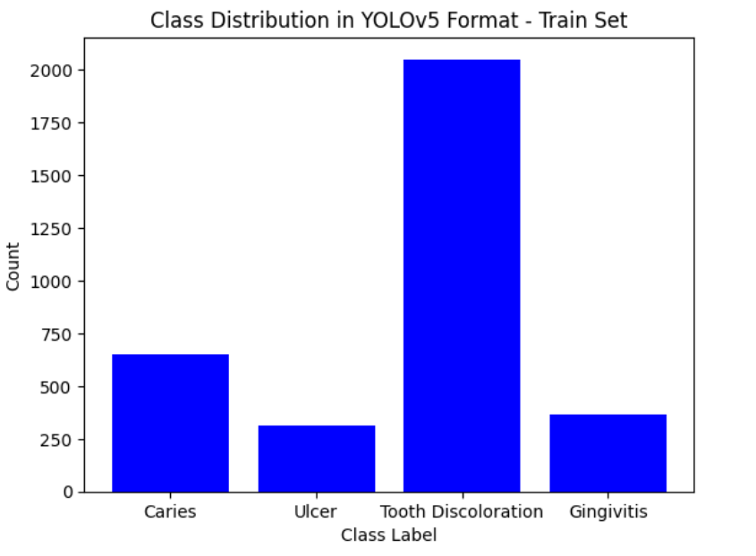
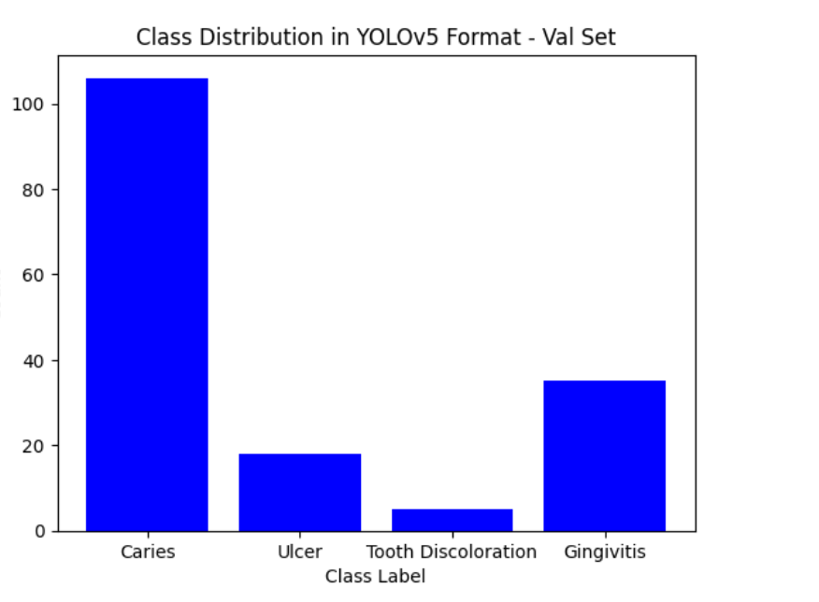
Issue 2

Slide 14
Classification Models
InceptionV3
MobileNet
VGG16
ResNet50

Slide 15
Why we chose these models
InceptionV3, VGG16, MobileNet, and ResNet50 are well-known and widely used models that have been pre-trained on large datasets like ImageNet.
They have different underlying structures. This diversity helps explore different approaches to feature extraction and classification, potentially capturing a wider range of patterns in the data.
These models have extensive documentation and community support. This can be crucial when troubleshooting, seeking advice, or incorporating updates and improvements. The popularity of these models ensures that you can find resources, tutorials, and discussions easily.

Slide 16
Models comparison
Accuracy:
Inception v3: Generally excels in dental disease detection, especially caries, with studies showing high accuracy.
MobileNet: Can achieve decent accuracy, but might struggle with subtle details crucial for early disease detection.
VGG16: Might not be as accurate as Inception v3 due to its deeper architecture and potential for overfitting on smaller dental datasets.
ResNet50: Can achieve high accuracy but might be computationally expensive for real-time applications.

Slide 17
Computational Efficiency:
Inception v3: Efficient but not the most lightweight option.
MobileNet: Designed for efficiency on mobile devices, making it ideal for resource-constrained environments.
VGG16: Relatively computationally expensive due to its many layers.
ResNet50: Efficient compared to VGG16 but still heavier than MobileNet.

Slide 18
Adaptability:
Inception v3: Modular structure allows fine-tuning for specific dental tasks with ease.
MobileNet: Less flexible for customization compared to Inception v3.
VGG16: Adaptability limitations due to its complex architecture.
ResNet50: Can be adapted, but not as straightforward as Inception v3.

Slide 19
Overall:
Inception v3: Strong contender for most scenarios due to its balance of accuracy, efficiency, and adaptability.
MobileNet: Best choice for resource-constrained environments, but accuracy might be compromised.
VGG16: Not ideal due to computational expense and limited adaptability.
ResNet50: High accuracy option, but potentially less efficient and adaptable than Inception v3.

Slide 20
Model | Layers | Epochs | Test Accuracy | Test Loss
Resnet50 | 512 | 10 | 0.73 | 0.836
 | 512 | 20 | 0.74 | 0.867
Inception | 512 | 10 | 0.866 | 0.391
 | 512 | 20 | 0.8803 | 0.348
Mobilenet | 512 | 10 | 0.69 | 1.113
 | 512 | 20 | 0.83 | 0.549
VGG16 | 512 | 10 | 0.65 | 0.819
 | 512 | 20 | 0.75 | 0.624

Slide 21
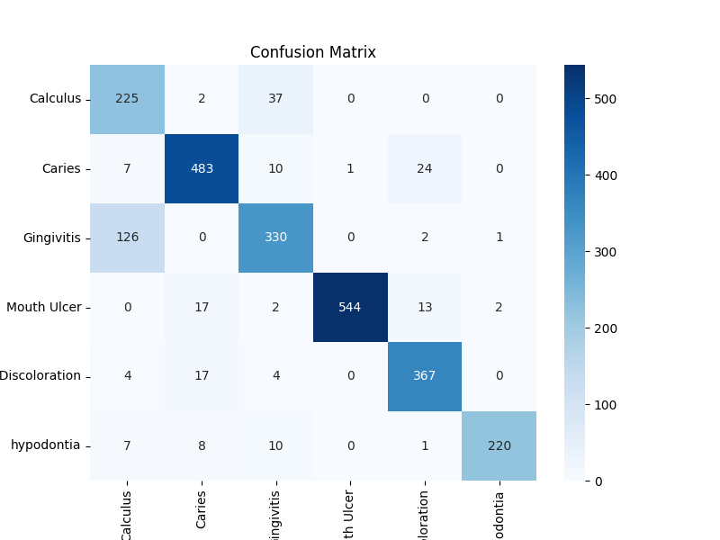
True
Predicted

Slide 22
Pros and cons of the whole project
Able to detect
Diseases Correctly in most image
Easy to use Interface
Did not achieve Desired level of accuracy
Sometimes the classification model and detection model results differ

Slide 23
Graphical User Interface
Used Gradio
Gradio is a valuable tool for creating interactive user interfaces for machine learning models with minimal effort.

Slide 24
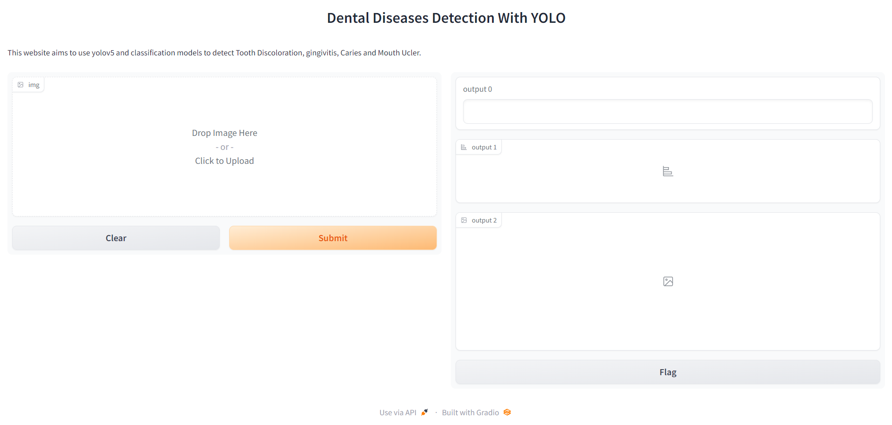
GUI

Slide 25
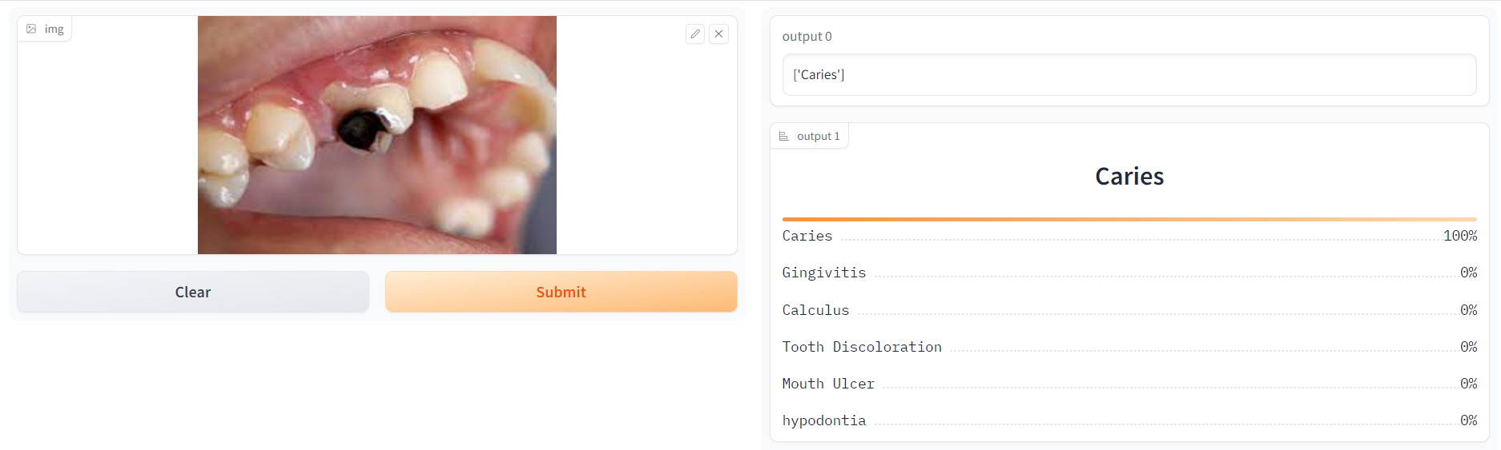
GUI

Slide 26
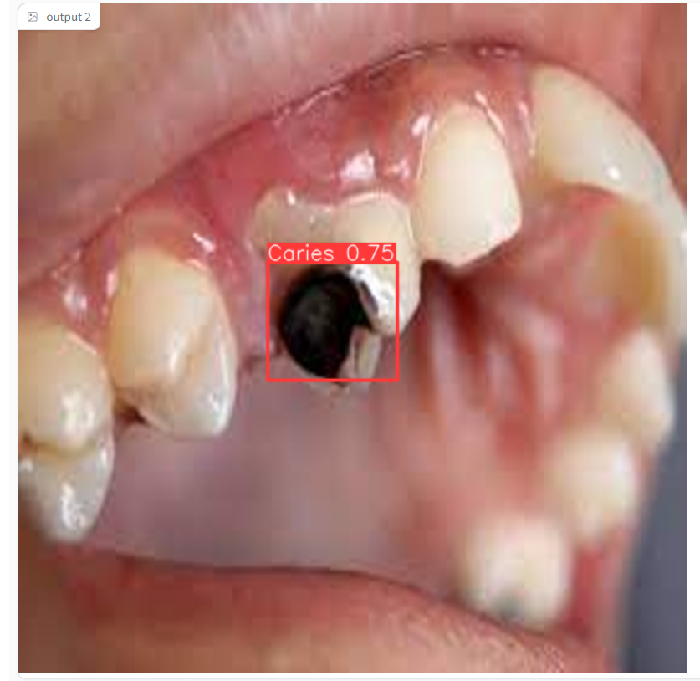
GUI

Slide 27
THANK YOU

